Slide 1
Performance of Knowledge Organization and Human Action using Probability Graphical Model and Efficiency Analysis
QME Project
Group - F
Trina Sahoo Matricola - 1901254
Debodeep Banerjee Matricola - 1901253
Octavianus Sinaga Matricola - 1907453
Ulviyya Jafarli Matricola - 1921169

Slide 2
Motivation and Objective -------------------------------------------
In this project we have collected a total of 71 papers from Scopus and WOS. For further studies we have selected 7 papers for literature review.
In this project we have used IBM Human Resource dataset which is based on Modelling human action. The purpose of studing on human resource is to emphasize the contribution of human and human resource management to organizational performance achievement.
The main objective of this project is to establish the relationship between human resource management and knowledge organization. We have set this objective as it has been seen from various library research that there is a relationship between human resource system as an element of organizational capital and role behavior as an element of human capital, in strategic human resource management, systematically.
In order to establish the relationship we consider the work life balance of the individual considering different parameters in the organizations by analysing the dataset based on human resource management by using different methods like systematic review, probability graphical model and efficiency analysis.

Slide 3
Literature Review
-----------------------------------------------
We have 4 parts in literature review:
Paper Review
Ontological Modelling (Eddy and Protegé)
Systematic review of the literature (PRISMA Model)
Conceptual Mapping (Scopus, VOSviewer, biblioshiny)
Paper Review
We have reviewed 7 paper based on the interest of our project. The list of the papers are given below:
Knowledge retrieval and personalization in virtual enterprises
The estimation of enterprise's human capital operation
Measuring knowledge management effectiveness in communities of practice
Knowledge management: A state of the practice summary
Knowledge assets and their scheduling of use within organizations
Variational learning of finite beta-liouville mixture models using component splitting
Building a more meaningful web: From traditional knowledge organizationsystems to new semantic tools.

Slide 4
Conceptual Mapping
Scopus:
We have analyzed the obtained papers based on the subject matter. From the figure it is evident that Business Management science covers 30.9% of the total.
VOSviewer:
This figure respresents the network visualization of the bibliographic data using organizations and the co-occurrence of the Author’s keywords. The distance between each cluster represnts organizations that are strongly related in terms of co-authorship.

Slide 5
Conceptual Mapping
Biblioshiny:
The first figure shows the relevant words related to our interest. It shows that knowledge management, intellectual capital, knowledge organizations and human capital are significant than other. These are the major parts which we are interested in our studies.
The second figure represents the clustering by documents. Each clusters represents a bunch of paper which are strongly related by documents. The knowledge organizations has greatest relevance of paper, the second largest cluster is knowledge management and so on.

Slide 6
Ontological Modelling
Eddy:
The ontological modelling on eddy is based on a generic overview of knowledge organization and modelling human action. The ontology is reported in the figure through the GRAPHOL ontological language, which provides a visual representation of OWL ontologies. It contain 12 classes: Organization, Knowledge, Funding, Patent, Talent, Project, Article, Human Action, Intellectual Capital, Assessing Quality, Profile and Functional Competency. A knowledge organization can be human action, intellectual capital and assessing quality. The figure represents these classes along with most relevant properties. The central class in human resource which has further model is profile and functional competency. Functional competencies are expressed in terms of knowledge, skills and abilities. They are also called job related competencies or technical competencies.

Slide 7
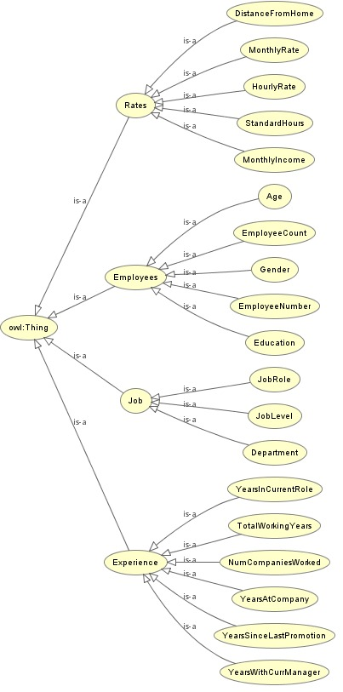
Ontological Modelling
Protegé:
Relational Graph of HR Dataset
35 attributes in data
Represented by 19 entities
4 main categories
Final OWLViz

Slide 8
Systematic review of the literature (PRISMA Model)
Meta-Analysis and Systematic Review for used bibliography
Resources used : Scopus/ WOS
Total sources used from Scopus and WOS = 85
Removed Duplicates before screening= 17
Excluded Reports = 8
Identified via other resources = 9(Mostly from websites and citation searching)

Slide 9
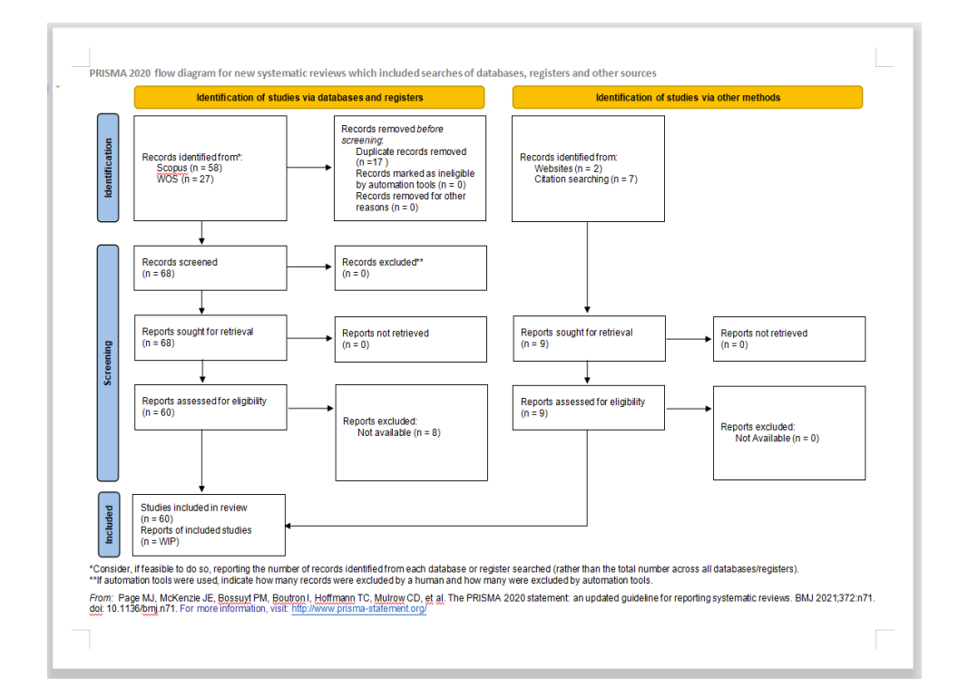
PRISMA Model

Slide 10
Dataset Summary -----------------------------------------------------------------
IBM HR Dataset. Consist of 34 variables:
Numerical variables: have numerical values for each data point (e.g: Age, DailyRate, DistanceFromHome, EmployeeCount, etc)
Categorical variables: consist of another type of the data(e.g. rating, boolean(true/false), 0/1, etc.) that usually categorized instead of having exact measurable values (e.g: Gender, JobRole, MaritalStatus, Over18, OverTime, Education, etc)

Slide 11
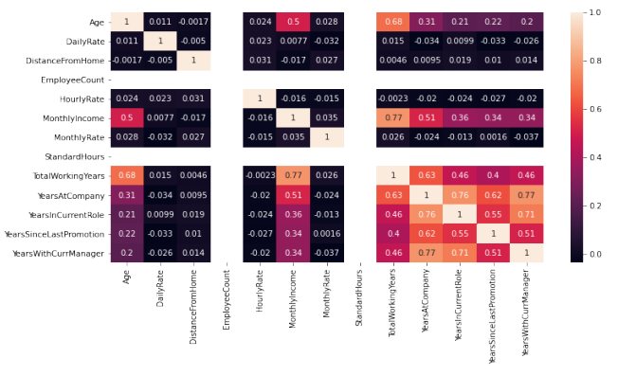
Exploratory Data Analysis --------------------------------------------------------------
Correlation between numerical values.
The number of total working variables is highly correlated with monthly income and age.
Number of working at company is highly correlated with: the number of year working with current manager, number of years in current role, and total working years.
Notes:
Exploratory data analysis: analyst characteristics of variables, get some base analysis between variables
Efficiency Analysis: Utilize numerical variables. Analyze efficiency between inputs and outputs.
Classification task: Find the attrition status of employees based on variables available on dataset (numerical and

Slide 12
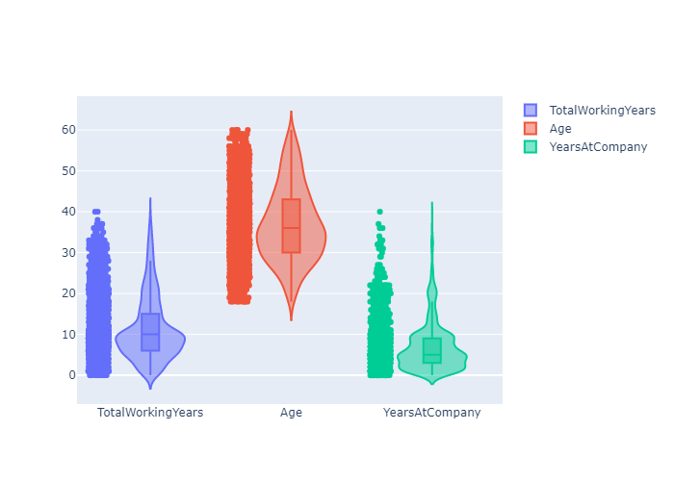
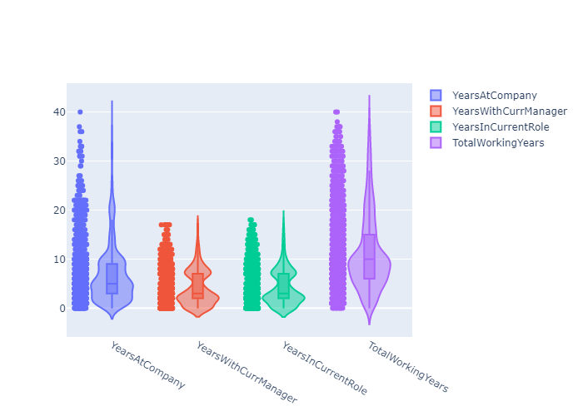
Exploratory Data Analysis(continued) -------------------------------------------------------------------
Violin plots for the numeric variables
-------------------------------------------------
For the total working years, we see that most of the employees has an experience of around 10 years.
The age tends to follow a normal distribution
The variables years at company and total working years contain outliers.
The median of years at company is higher than the median of total working years.
Years with current manager and years with current role has almost same shape but most the later one has greater range.

Slide 13
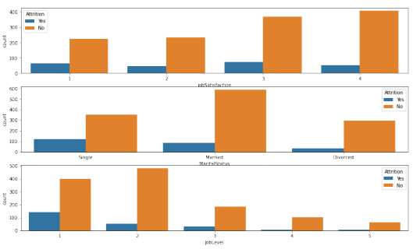
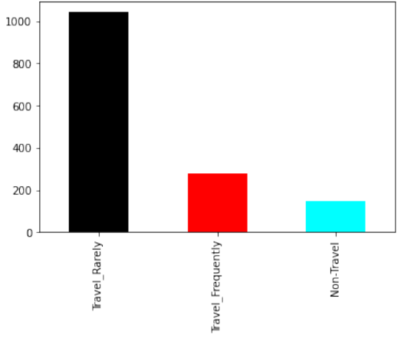
Exploratory Data Analysis(continued) ----------------------------------------------------------------
Observation
In each of cases, the attrition is high towards ‘No’.
Observation:
Most of the employees travel rarely.

Slide 14
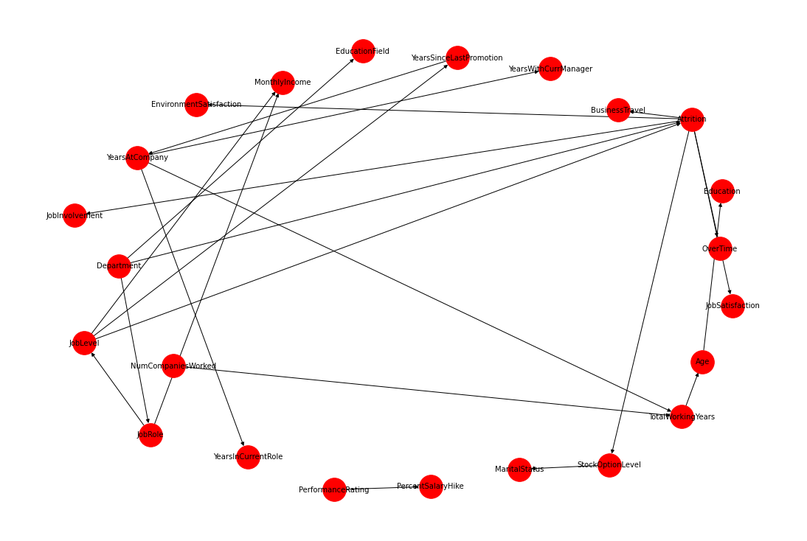
Probabilistic graphical modelling -------------------------------------------------------------------
Node years at company has an influence on the total working years which in turn has an effect on age of the employee. That absolutely makes sense.
when we see that Age influences over time and overtime eventually influences the education of the employee, then that doesn’t make much sense.

Slide 15
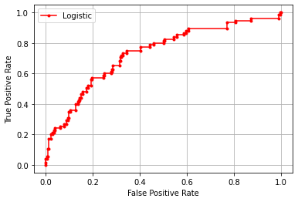
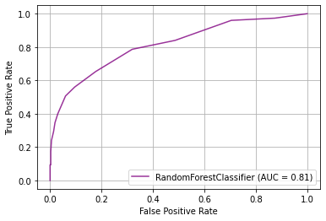
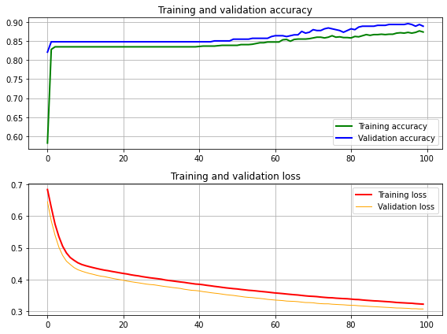
Classification techniques -------------------------------------------------------------------
Technique and accuracy
---------------------------------------
Variable to be classified: Attrition
Logistic regression : 73%
Random forest : 81%
Neural Network: 89%

Slide 16
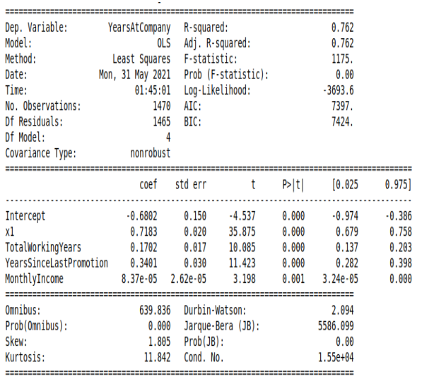
Efficiency Analysis: Hypothesis Testing ---------------------------------------------------------------------
Output: Years at company (loyality)
Inputs: time in current position(average between in same manager and same role), total working years, working years since last promotion, and monthly income.
Hypothesis testing for statistics: p-value with confidence interval (a = 0.05)
Notes:
Exploratory data analysis: analyst characteristics of variables, get some base analysis between variables
Efficiency Analysis: Utilize numerical variables. Analyze efficiency between inputs and outputs.
Classification task: Find the attrition status of employees based on variables available on dataset (numerical and

Slide 17
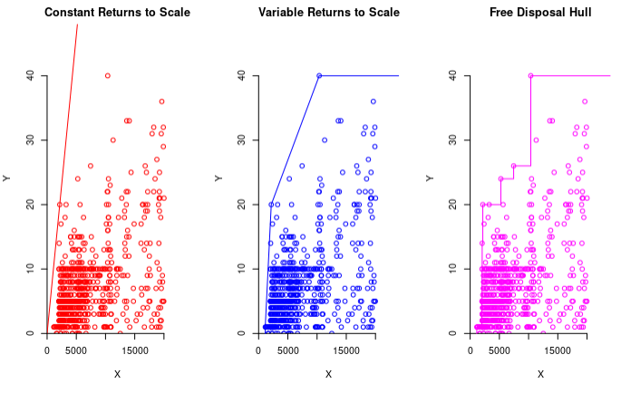
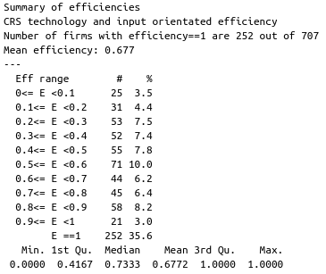
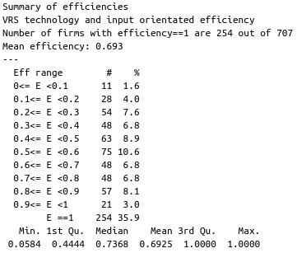
Efficiency Analysis: CRS, VRS, FDH ---------------------------------------------------------------
Based on the result, VRS is resulting better efficiency
Notes:
Exploratory data analysis: analyst characteristics of variables, get some base analysis between variables
Efficiency Analysis: Utilize numerical variables. Analyze efficiency between inputs and outputs.
Classification task: Find the attrition status of employees based on variables available on dataset (numerical and

Slide 18
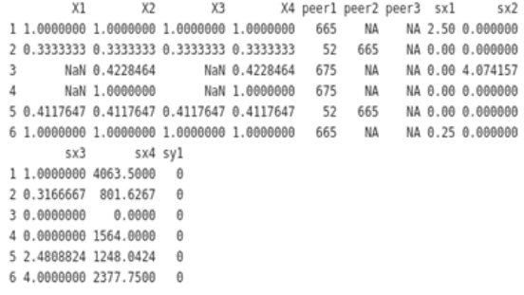
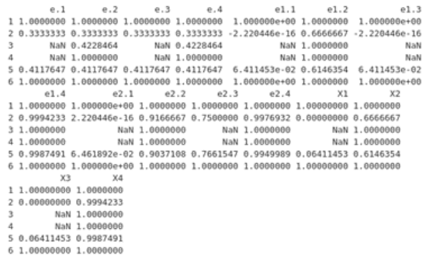
Efficiency Analysis: DDF -----------------------------------------------------------------------
DDF with variables itself to direct (left) vs using random scalar to direct (right)
Efficiency works better with the selected scalar values than selecting the variables itself as direction
Notes:
Exploratory data analysis: analyst characteristics of variables, get some base analysis between variables
Efficiency Analysis: Utilize numerical variables. Analyze efficiency between inputs and outputs.
Classification task: Find the attrition status of employees based on variables available on dataset (numerical and

Slide 19
Conclusion -----------------------------------------------------------------------
The project provides an investigation on the relationship between human resource management and knowledge organization
Obtained results by using the VOSviewer, Biblioshiny and Scopus, it is demonstrated that there is a link between intellectual capital, human activity and knowledge organization, and quality assessment is not in the spotlight as it is a factor in all of the above
Classification task to predict the attrition of employees given some factors/ variables from each employees has been done and NN gave best result amongst others (logistic regression and random forest
VRS is choosen for the efficiency analysis and shown better efficiency performance.
Notes:
Exploratory data analysis: analyst characteristics of variables, get some base analysis between variables
Efficiency Analysis: Utilize numerical variables. Analyze efficiency between inputs and outputs.
Classification task: Find the attrition status of employees based on variables available on dataset (numerical and

Slide 20
Thank you

